Slide 1
DD2437 - ANNDA
Lab assignment 1
Single and multi-layer perceptrons in practice
Notes:
So… Hi. We’re group 17 and this is our presentation of the first lab assignment. Ths lab dealt with the implementation and use of single and multi-layer perceptrons.

Slide 2
Assignment part I
Classification, encoding and regression
Notes:
In the first part of the lab, the focus was on the Perceptron, Delta and the generalized Delta rule for two-layer perceptrons.
Here we designed neural networks for classification, encoding, and function approximation.

Slide 3
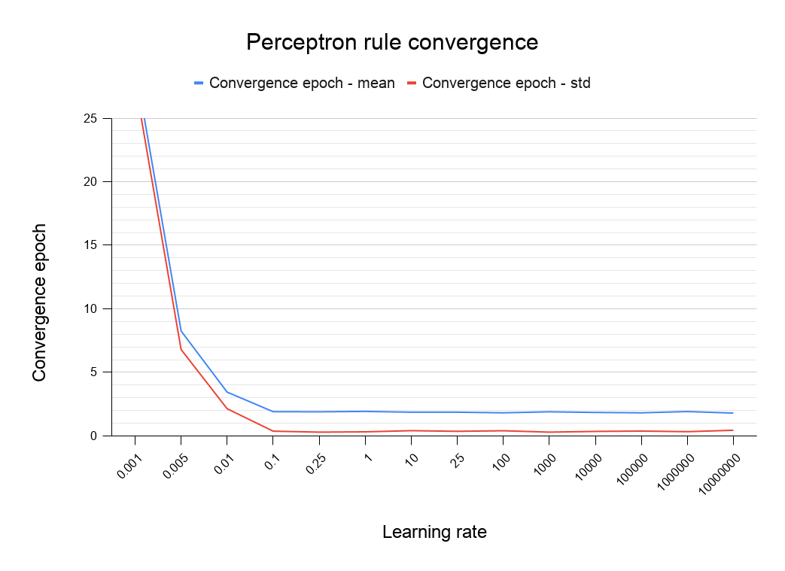
Classification using a single layer perceptron
Perceptron Learning
Notes:
Regular perceptron converges very fast because it stops after reaching 100% accuracy (the first fitting linear separator).
It tends to be faster but worse at generalization than Delta rule since Delta also minimizes Mean Square Error.
Even with very large learning rates, perceptron converges!

Slide 4
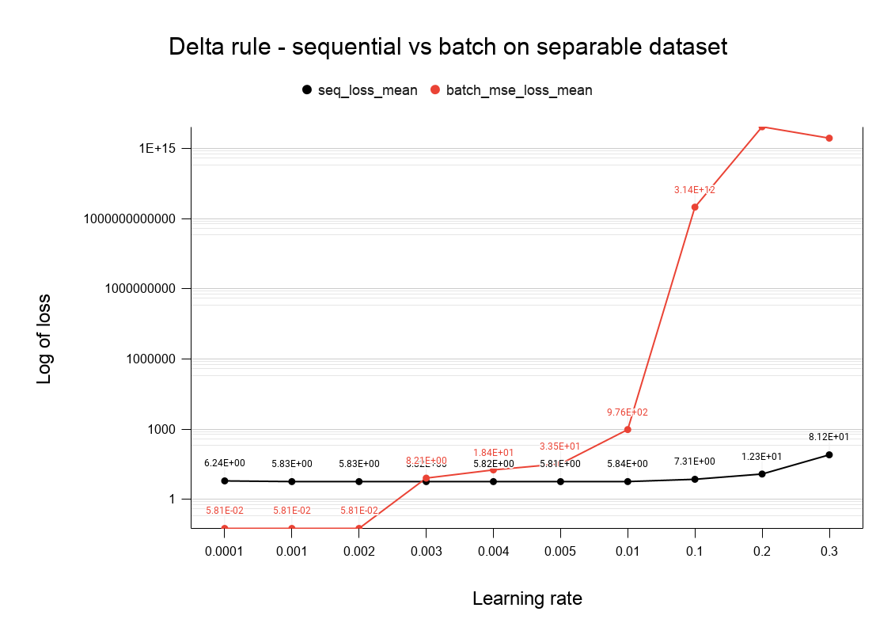
Delta Rule: hyper-parameters
Notes:
Choice of the learning rate hyperparameter matters a lot, especially in batch mode that does huge updates in one go, passing a certain threshold it makes the model overshoot (red line)
Sequential is more robust to local minima and converges quicker, but usually minimises loss (MSE in this case) less well.
For weights initialization; It matters less for batch mode because of the “big updates” it’s making, compared to sequential where starting point matters and a poor choice delays convergence

Slide 5
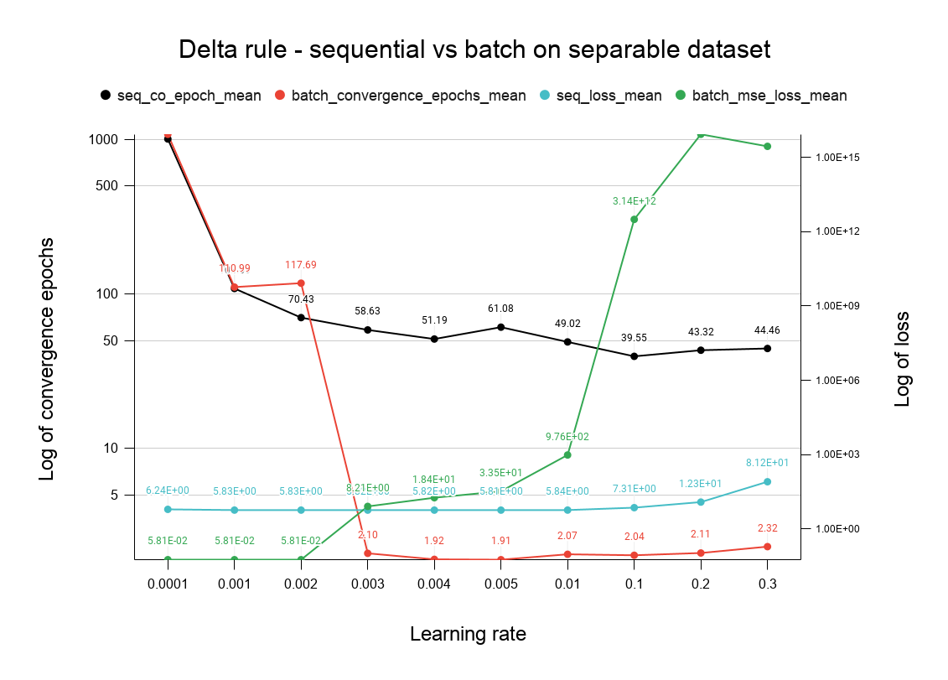

Slide 6
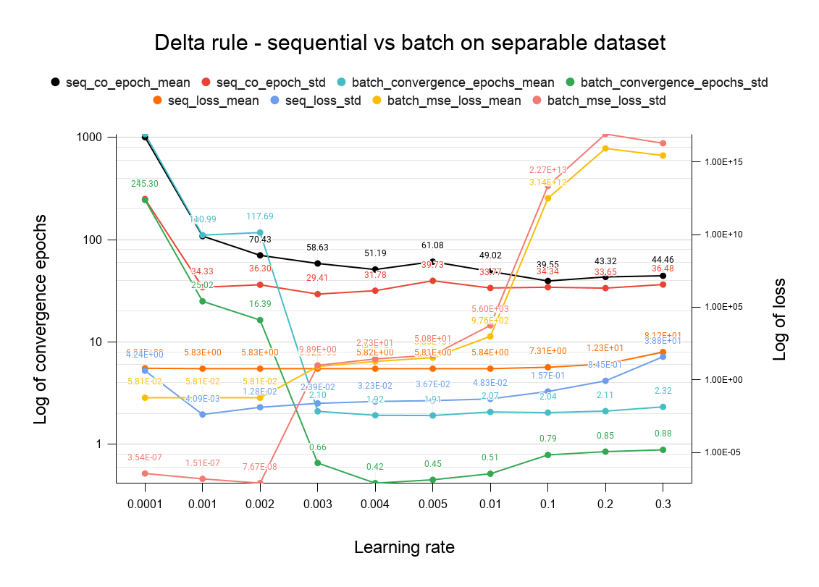

Slide 7
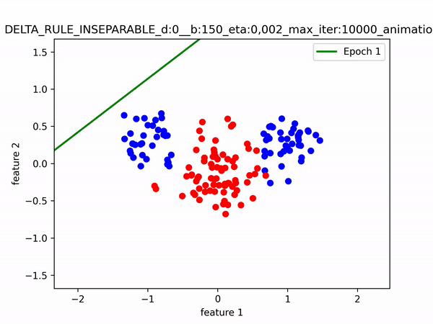
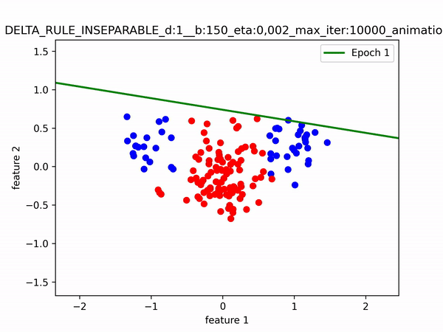
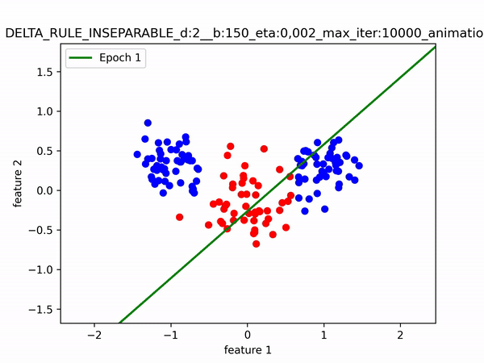
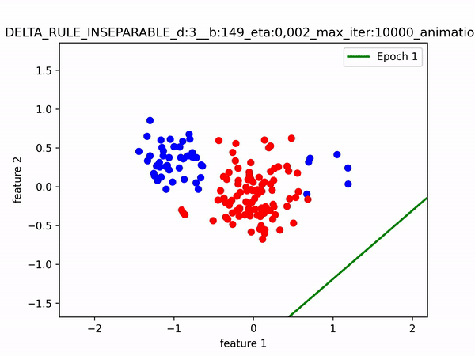
Subsampling effect on non-linearly separable data
(a) -25% each
(b) -50% class A
(c) -50% class B
(d) -20% class A(x1 < 0); -80% class A(x1 > 0)
Notes:
From non-linearly separable dataset from the assignment
Training animation on each subsampled dataset scenario

Slide 8
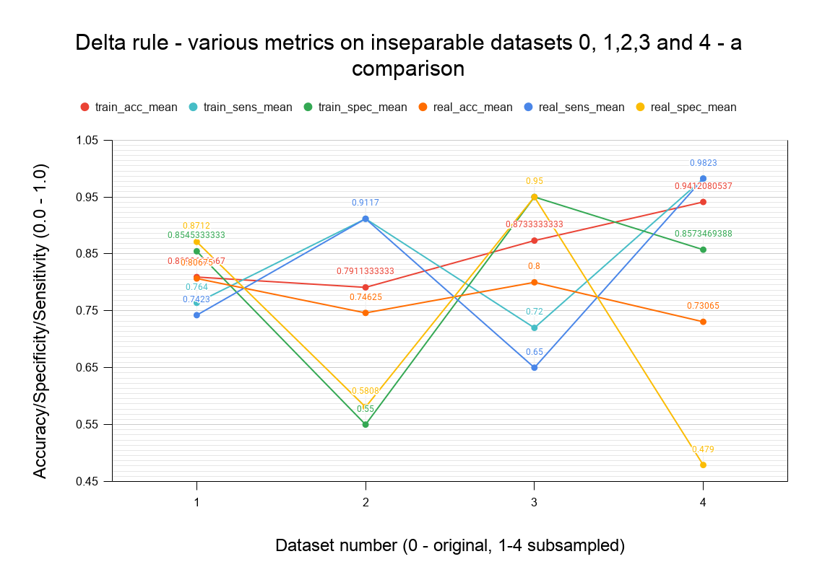
Trained model performances on each scenario (real: original dataset)
Notes:
When Subsampling on non-linearly separable data, the model will penalize a minority class to maximize accuracy: this affects the generalisation negatively.
Holding out data in this way leads to poorer performance, the training data is not representative.
Red line: train acc Vs Orange line: whole dataset acc; It’s the same on point 1 then real one is always worse
Yellow vs blue line on point 4: last scenario where the model is very polarized on one of the classes
(spec = TN / All negative drops, sens = TP/ All Positive rises)
Details:
specificity - in our scenario the same as the accuracy for class A
sensitivity - in our scenario the same as the accuracy for class B
Dataset 1 - similar performance for validation and train because the distribution is representative. 25% taken out from both classes
Dataset 2 - Sensitivity (class B accuracy) is better, becase 25% of class A were taken out from train set. Thats also why the specificity is low!
Dataset 3 - Specificity (class A accuracy) is better, becase 25% of class B were taken out from train set. Thats also why the sensitivity is low!
Dataset 4 - Sensitivity (class B accuracy) is very good, but the specificitiy (class A accuracy)

Slide 9
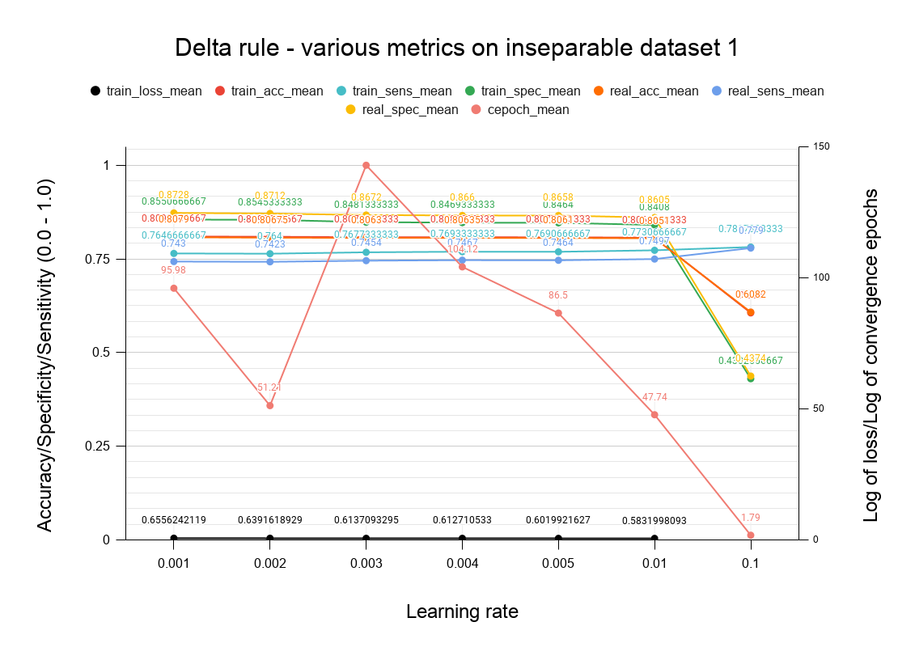

Slide 10
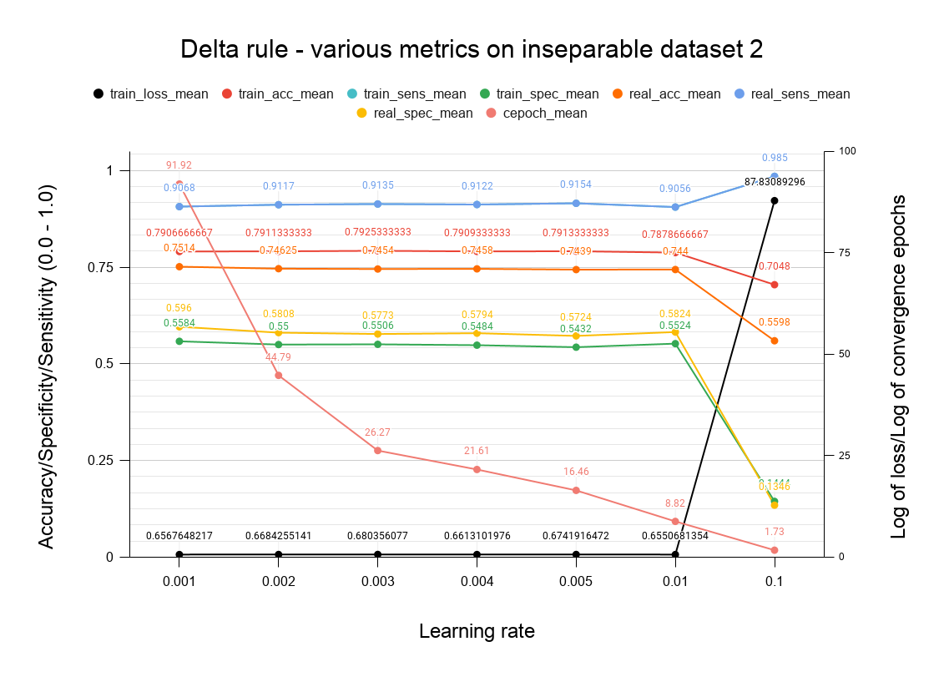

Slide 11
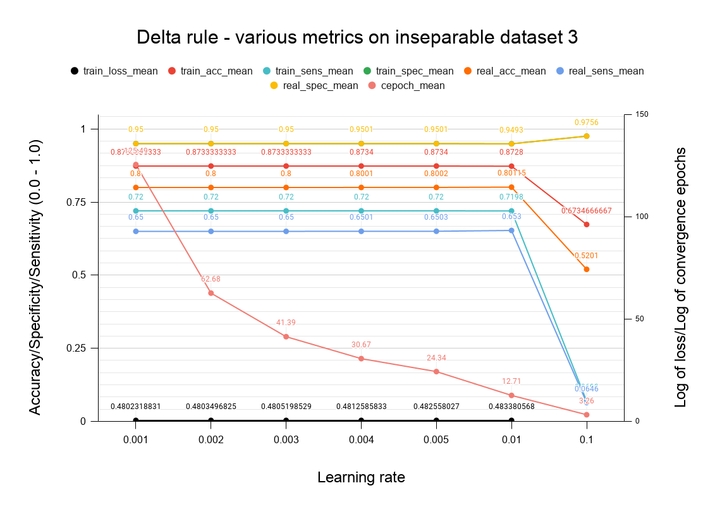

Slide 12
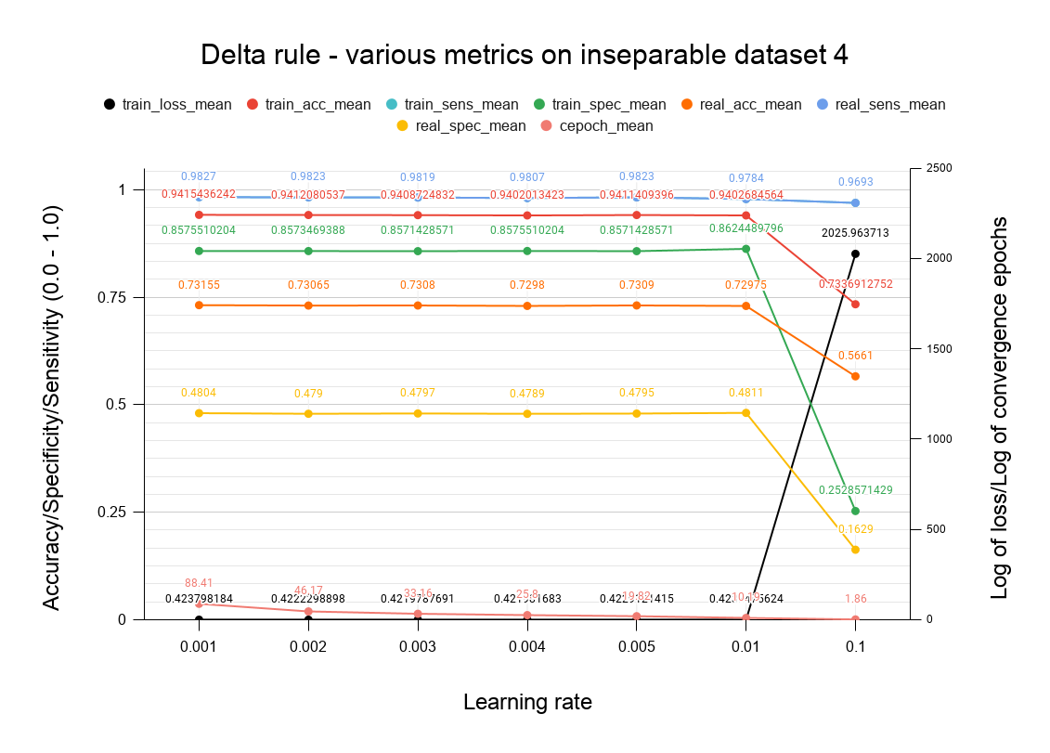

Slide 13
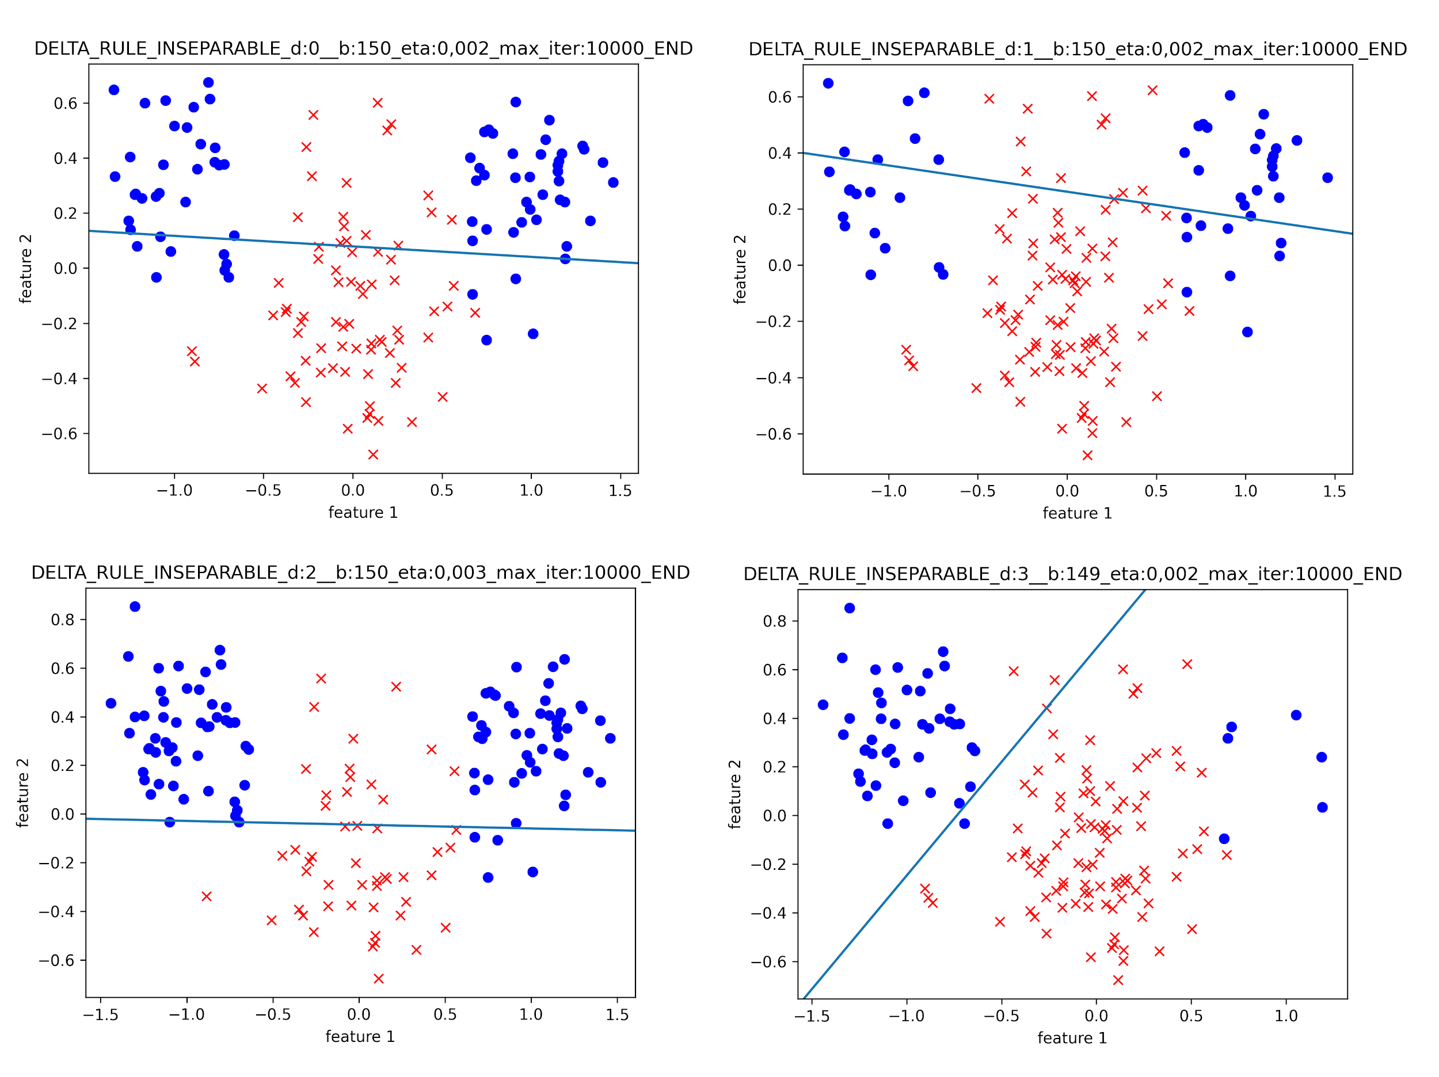
Final decision boundaries
Notes:
Illustrate the conclusions from last slide

Slide 14
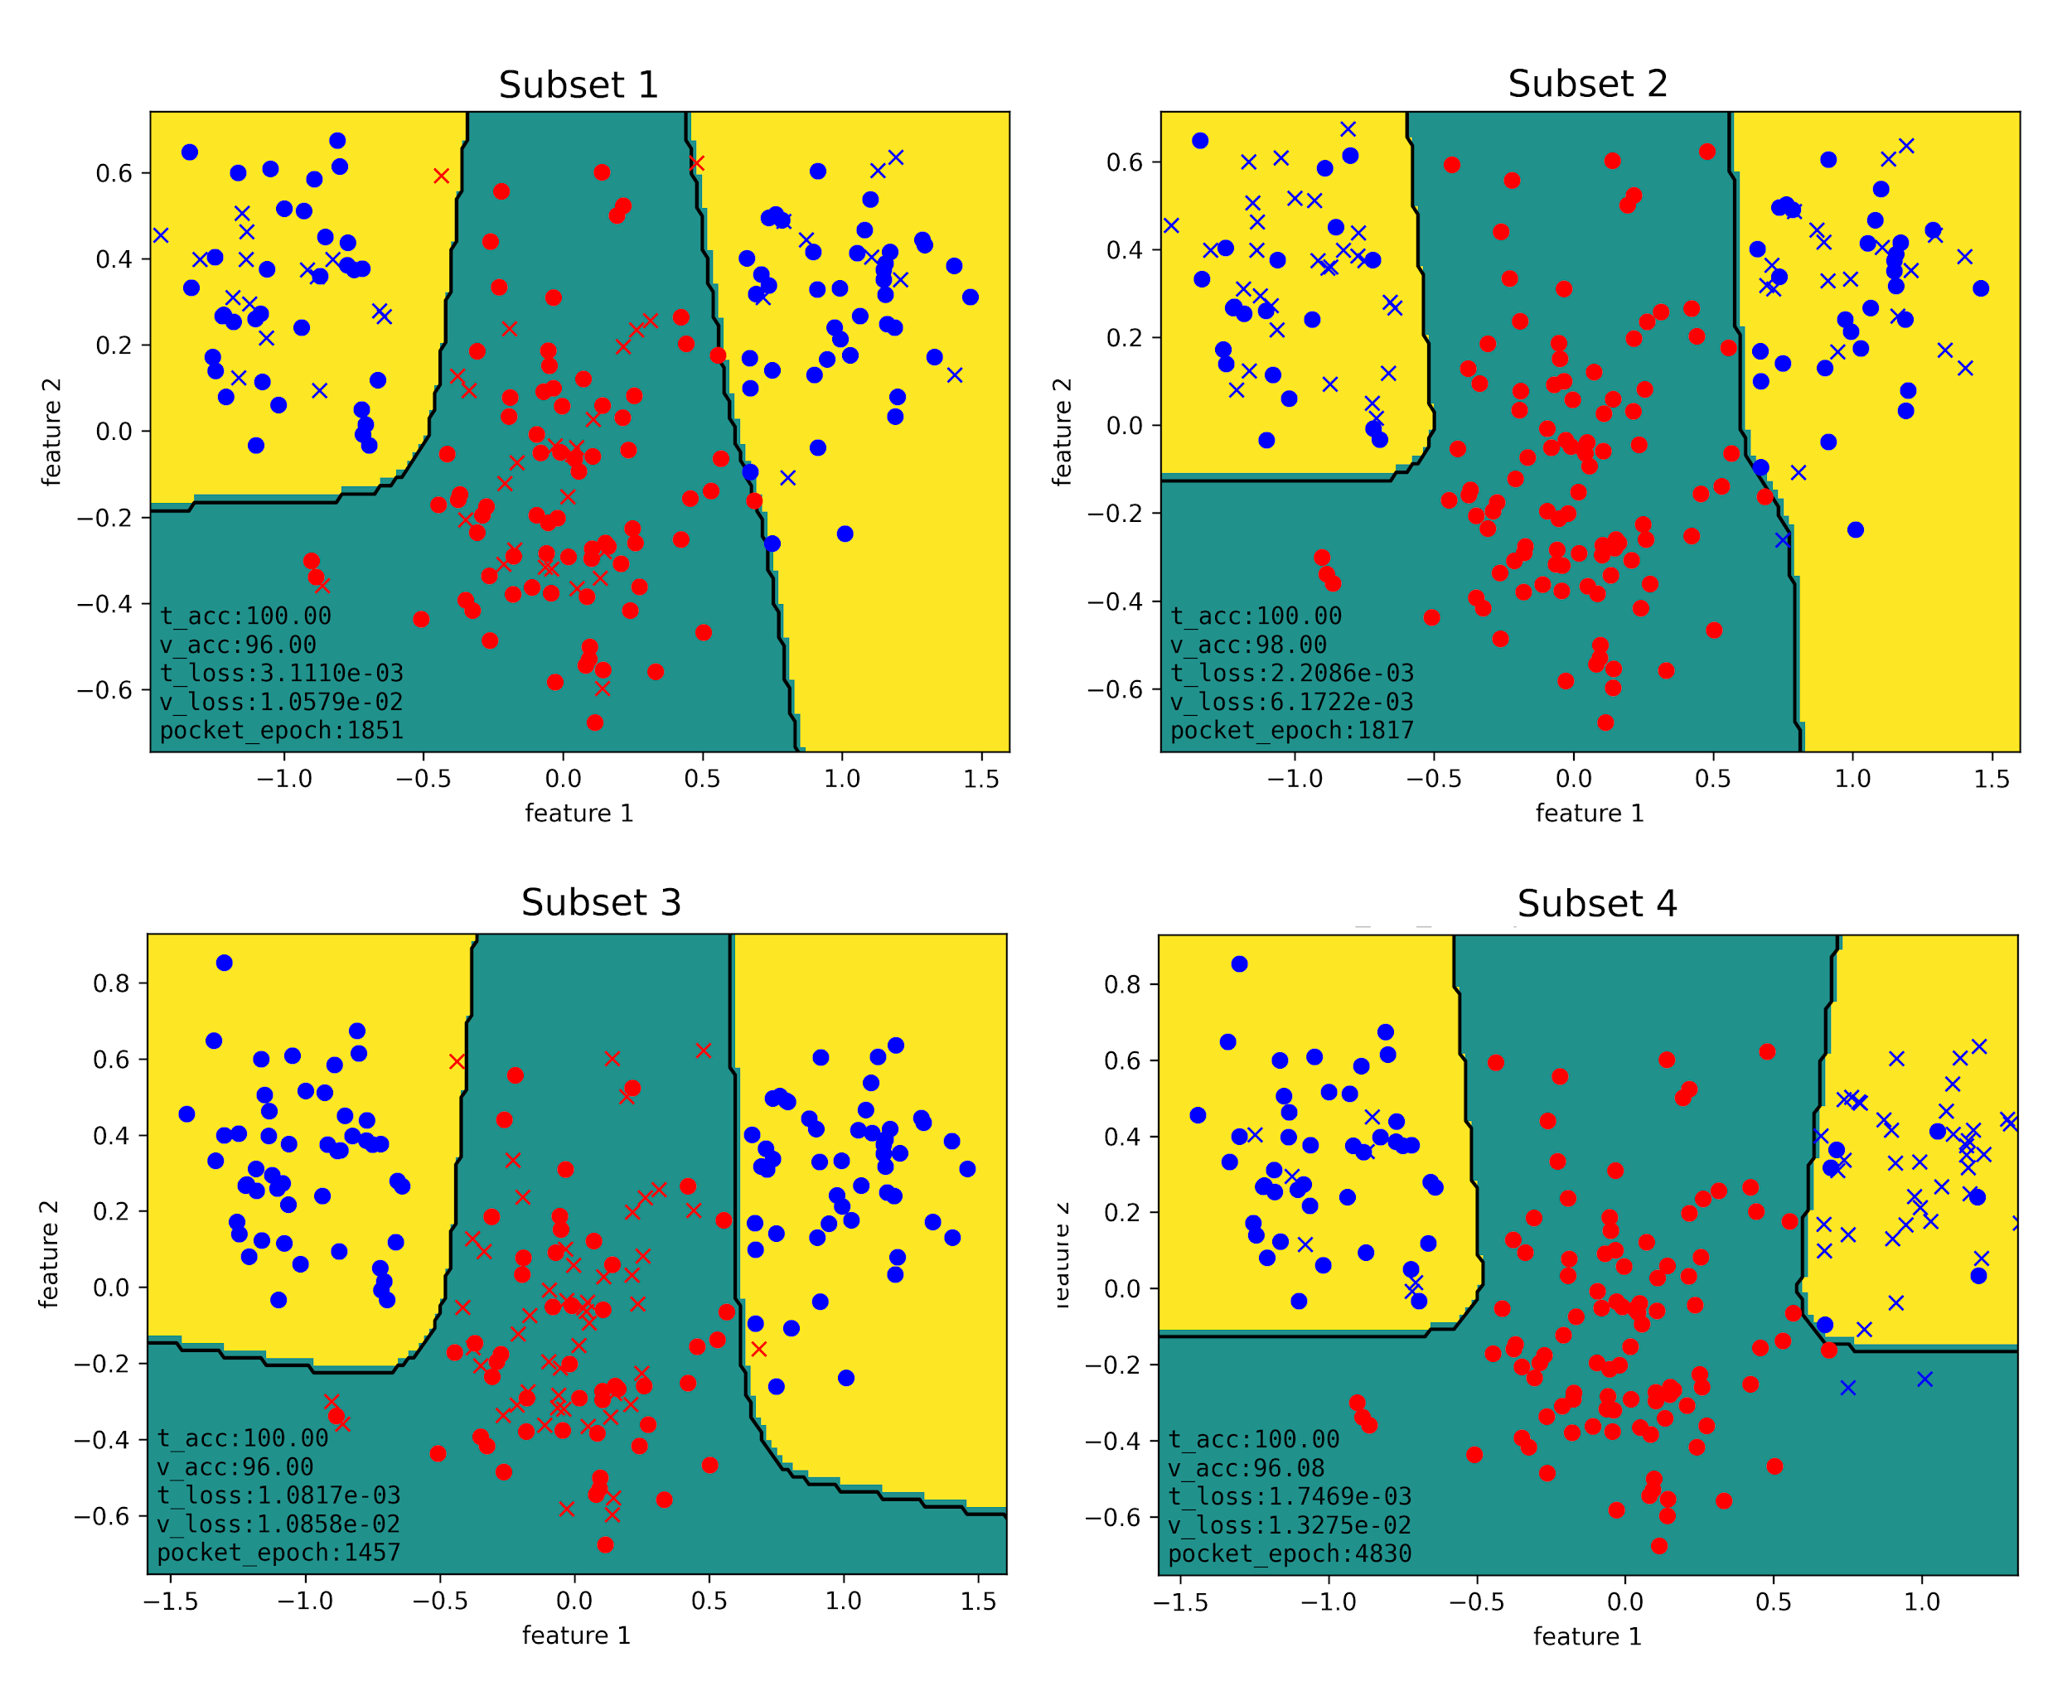
Classification & Regression using a two layer perceptron
Non-linearly separable data
MLP: 2-3-1
lr = 0.05
Notes:
Having one hidden layer gives us the sufficient complexity to classify non-linearly separable data
A minimum of 3 nodes is required to reach a good accuracy; We can see why with the following decision boundaries;
One sigmoid function gives a line, two sigmoid functions give two lines, so the two cannot create a complex enough boundary.

Slide 15
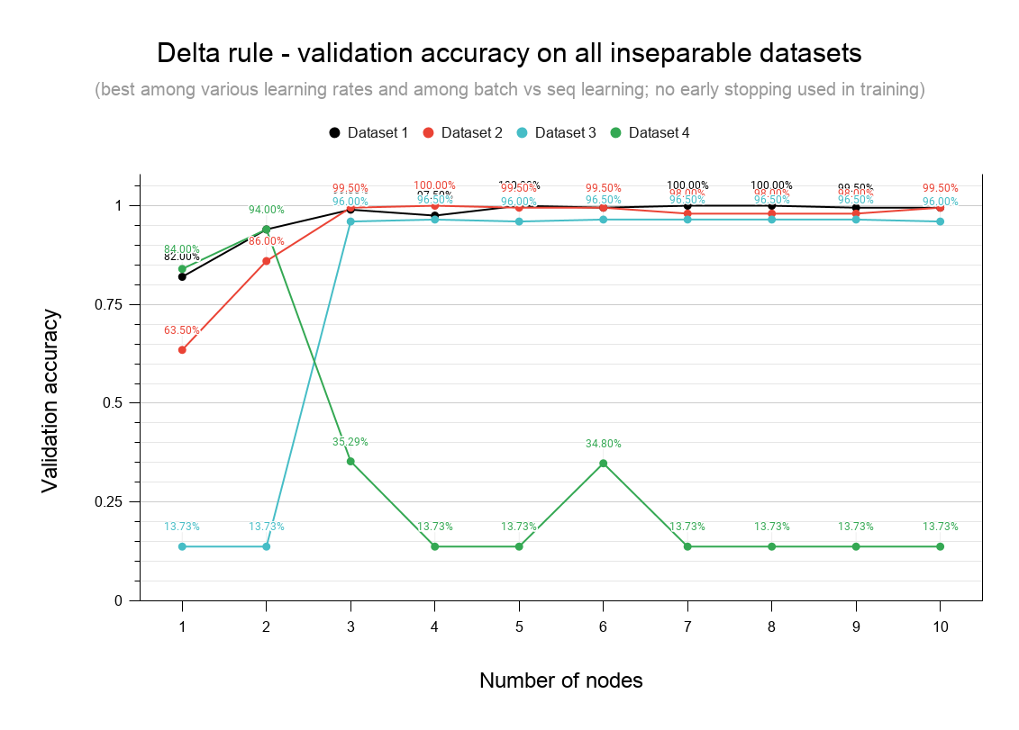

Slide 16
Auto-encoders architectures for data compression problem
8-3-8
The networks uses a binary encoding to map the 8 (2³) patterns
8-2-8
Successfully maps all inputs with a different representation
MLP can be used to compress data
Notes:
We reach 100% accuracy with both architectures; A more hidden representation if found for the 2 nodes hidden layer architecture; this demonstrates that nodes with their weights carry more than 1 bit of information.

Slide 17
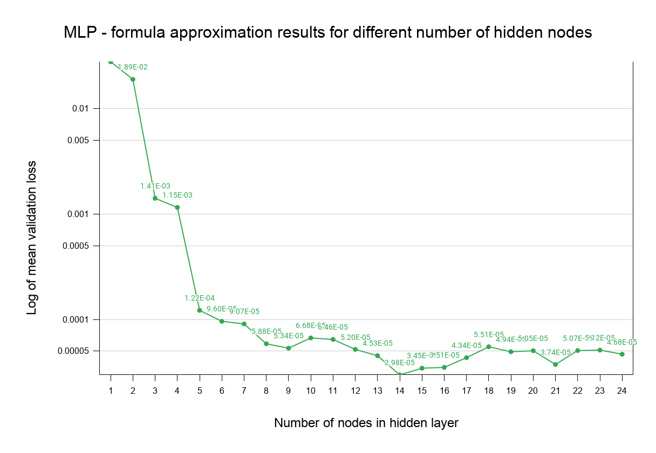
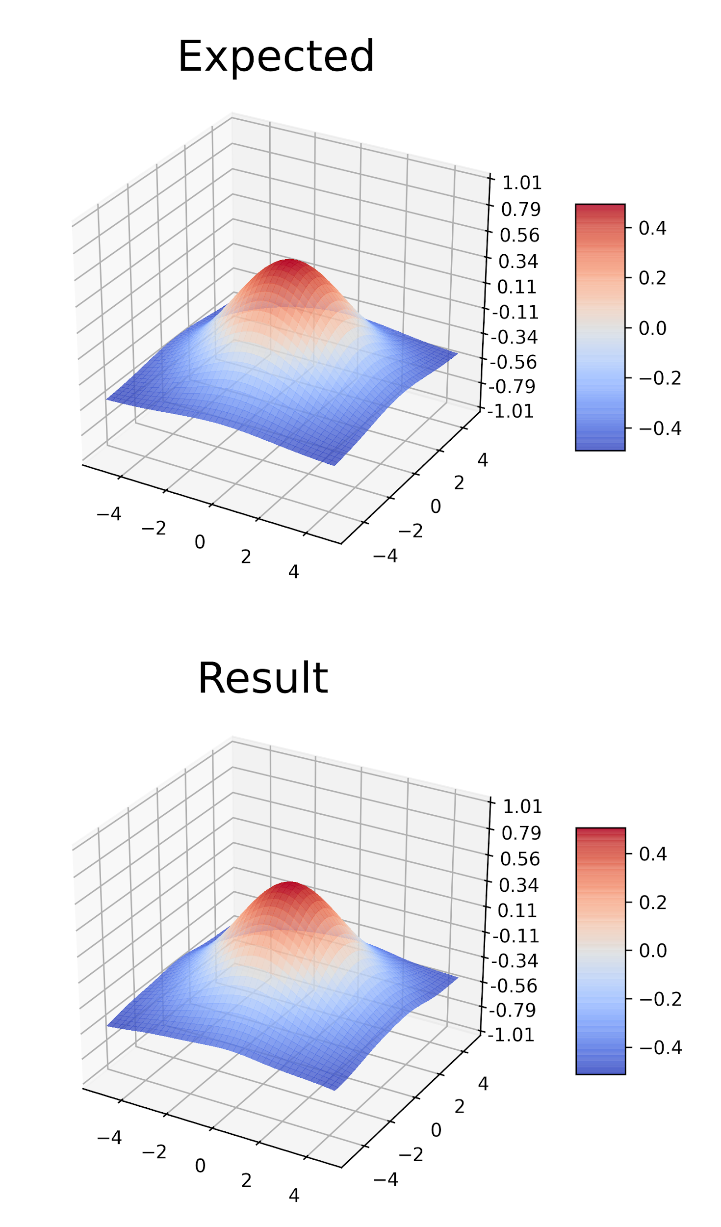
Function approximation
14 nodes architecture
lr = 0.5
Notes:
MLPs: good to approximate functions; 2 layer perceptron tuning (#nodes; eta {0.25, 0.5}) to approximate the Gaussian normal function
We achieve good results for architecture with above 8 neurons in the hidden layer
Train/Validation Set split didn’t changed much in terms of generalization: functions works well with overfitting

Slide 18
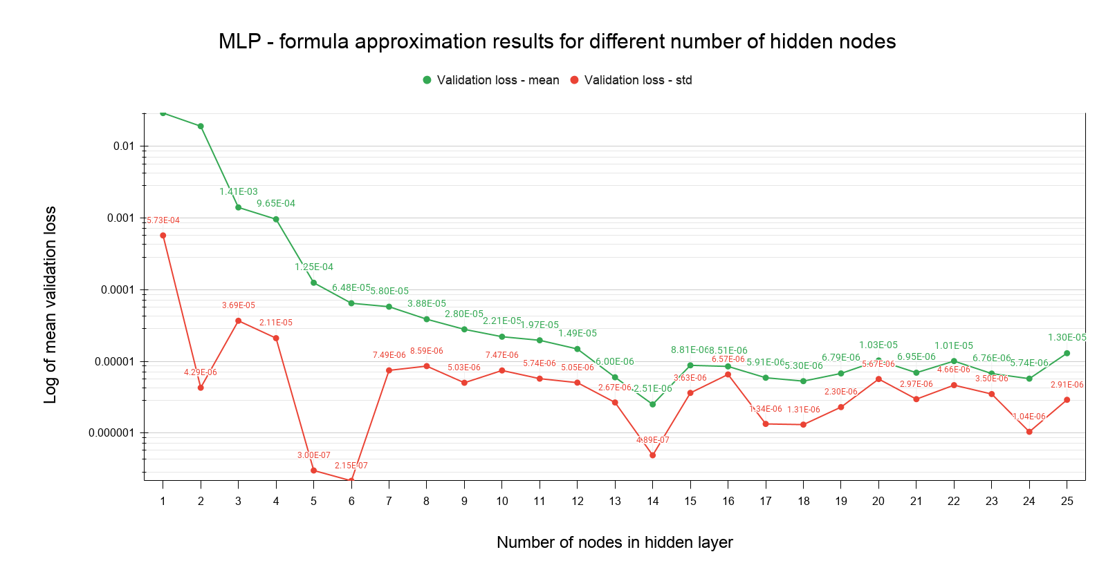

Slide 19
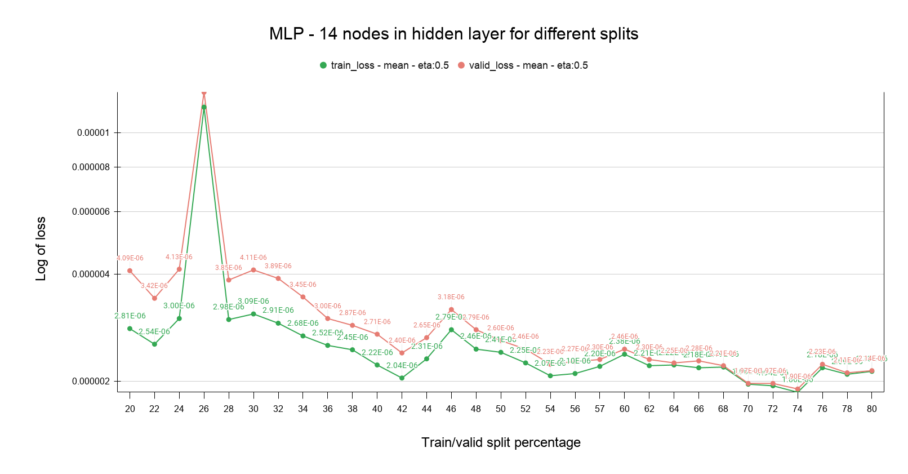

Slide 20
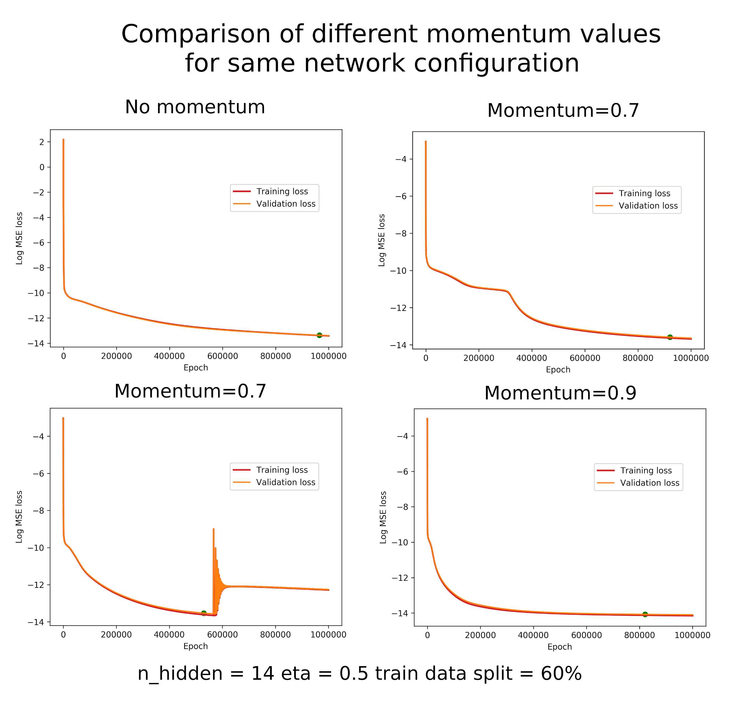
Momentum
speeds up convergence
Notes:
The convergence of the best model can be sped up using momentum, however this introduces yet another hyperparameter to tune.
The performance metric does not get worse.
Sometimes momentum makes the gradient descent go crazy, like on the bottom left. This is amusing.

Slide 21
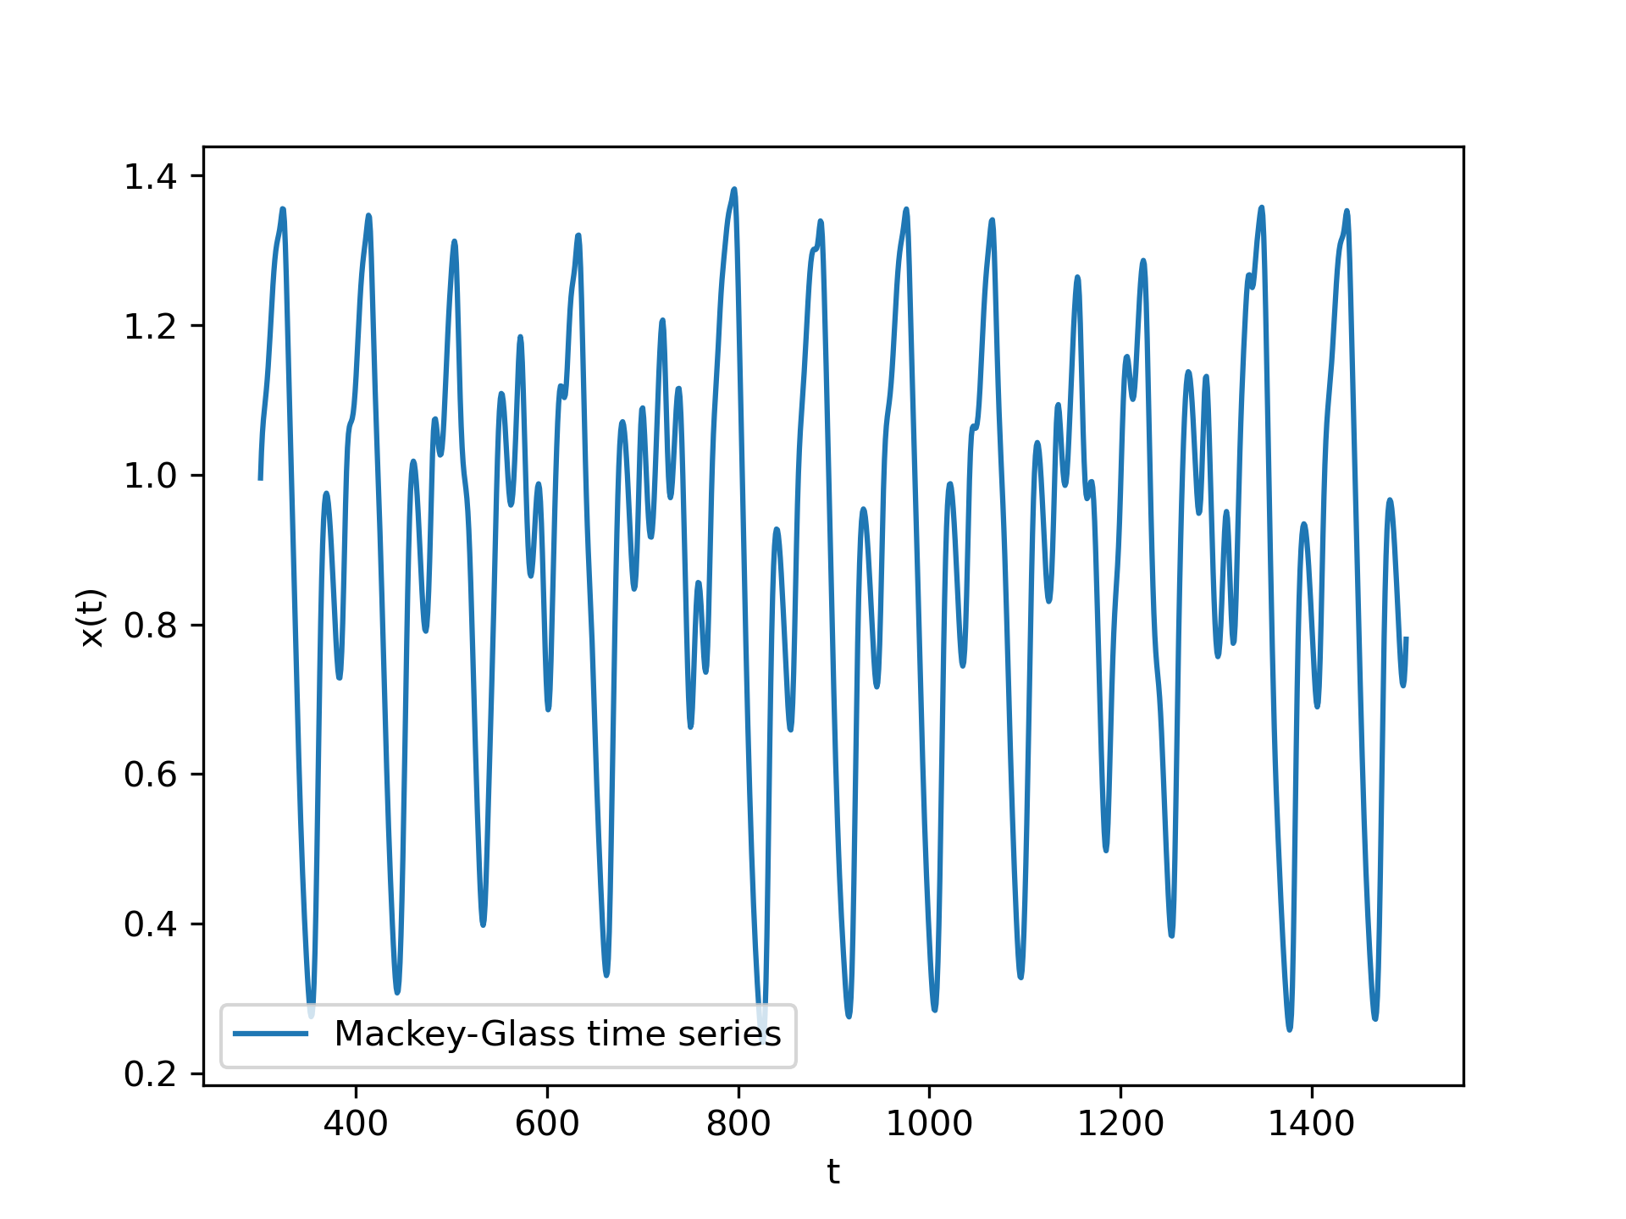
Assignment part II
Multi-layer perceptron and the prediction of the chaotic Mackey-Glass time-series
Mackey-Glass time series
Notes:
In part two of our assignment we’ve used multi-layered perceptrons, specifically 2 layer and 3 layer perceptrons with up to 8 hidden nodes per layer to predict the chaotic Mackey-Glass time series which we can see on the picture to the right. (the ambition was to deliver a robust solution with good generalization capabilities)

Slide 22
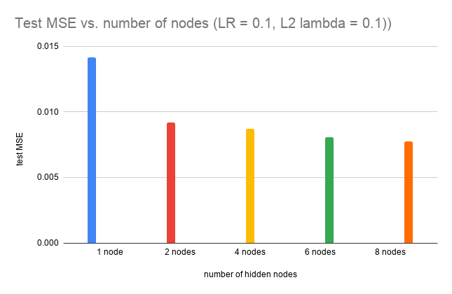
Noiseless data: two-layer perceptron selection
early stopping and L2 weight decay
best results
8 hidden nodes
learning rate 0.15
model performance with fixed parameters
Notes:
Firstly, we’ve used the Mackey-Glass time series without noise to select a good configuration for a two-layer perceptron. Figure (a) shows relative validation performance of 2 layer perceptrons with 1, 2, 4, 6 and 8 nodes with a fixed learning rate and weight decay, and demonstrates that the error of the model with 8 hidden nodes performs best. For a good result a learning rate of 0.15 was used. (learning rates of 0.1, 0.15, 0.2 were tested, lower than that was slow...)

Slide 23
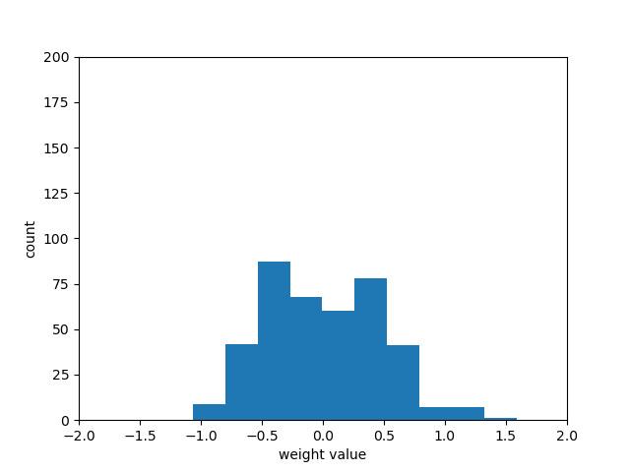
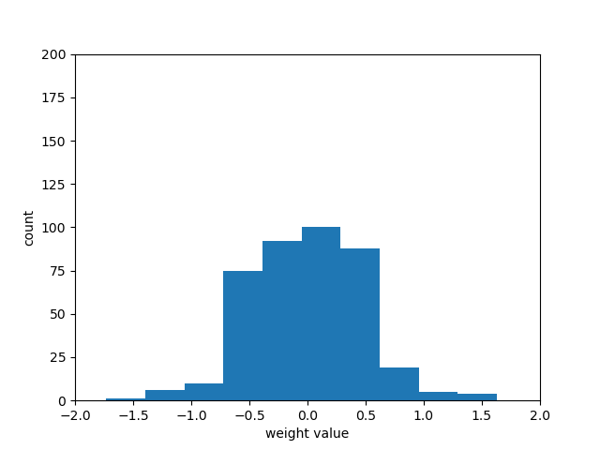
Noiseless data: regularization
L2 weight decay regularization
best results for 8 hidden nodes - lambda = 0.01
No regularization vs. L2 w/ lambda = 0.1
Notes:
Furthermore, we have tested the influence of regularization, specifically L2 weight decay on the networks’ performances as well as their weight distribution. The effects of weight decay can be seen in figure (a), regularized networks generally have weight distributions with thinner tails, more normally distributed around 0 as opposed to using no regularization. The network with 8 hidden layers performed best using a lambda of 0.01.

Slide 24
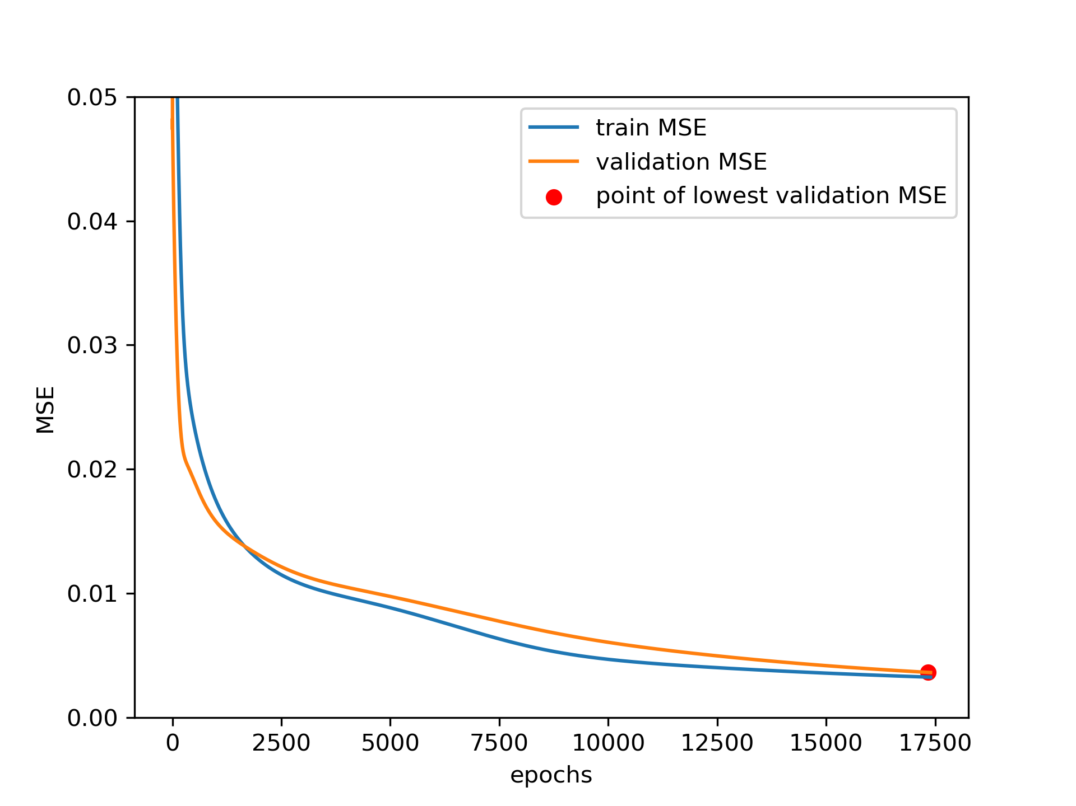
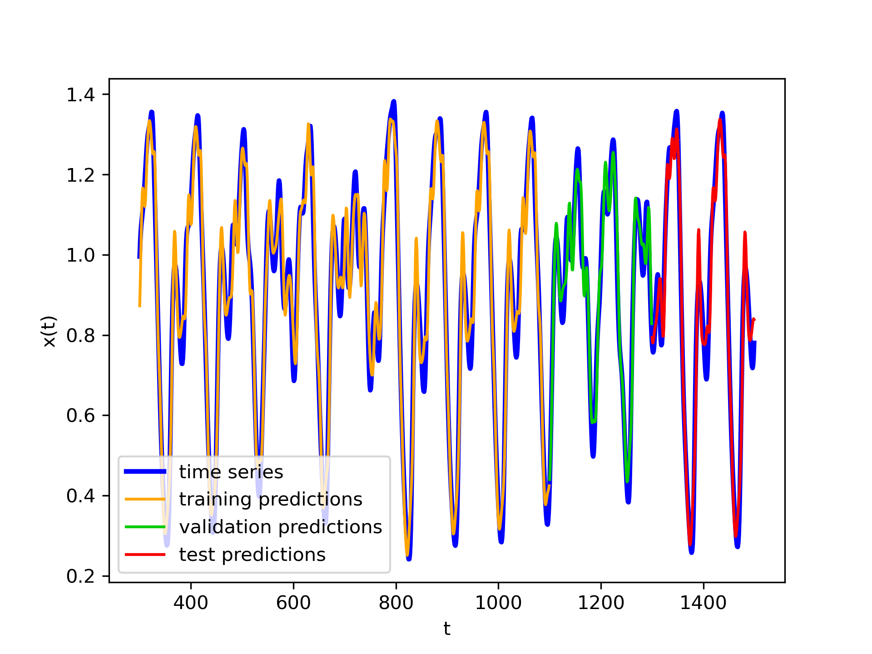
Noiseless data: results
test MSE approx. 0.005
(a) learning curves
(b) time series predictions
Notes:
Here are the plots of the learning curves and the predictions of our best model (8 nodes in the hidden layer). As expected the validation error is slightly higher than the training error, but we can see that the model has no problems with overfitting since their difference is quite small. The predictions clearly show a well modeled function.

Slide 25
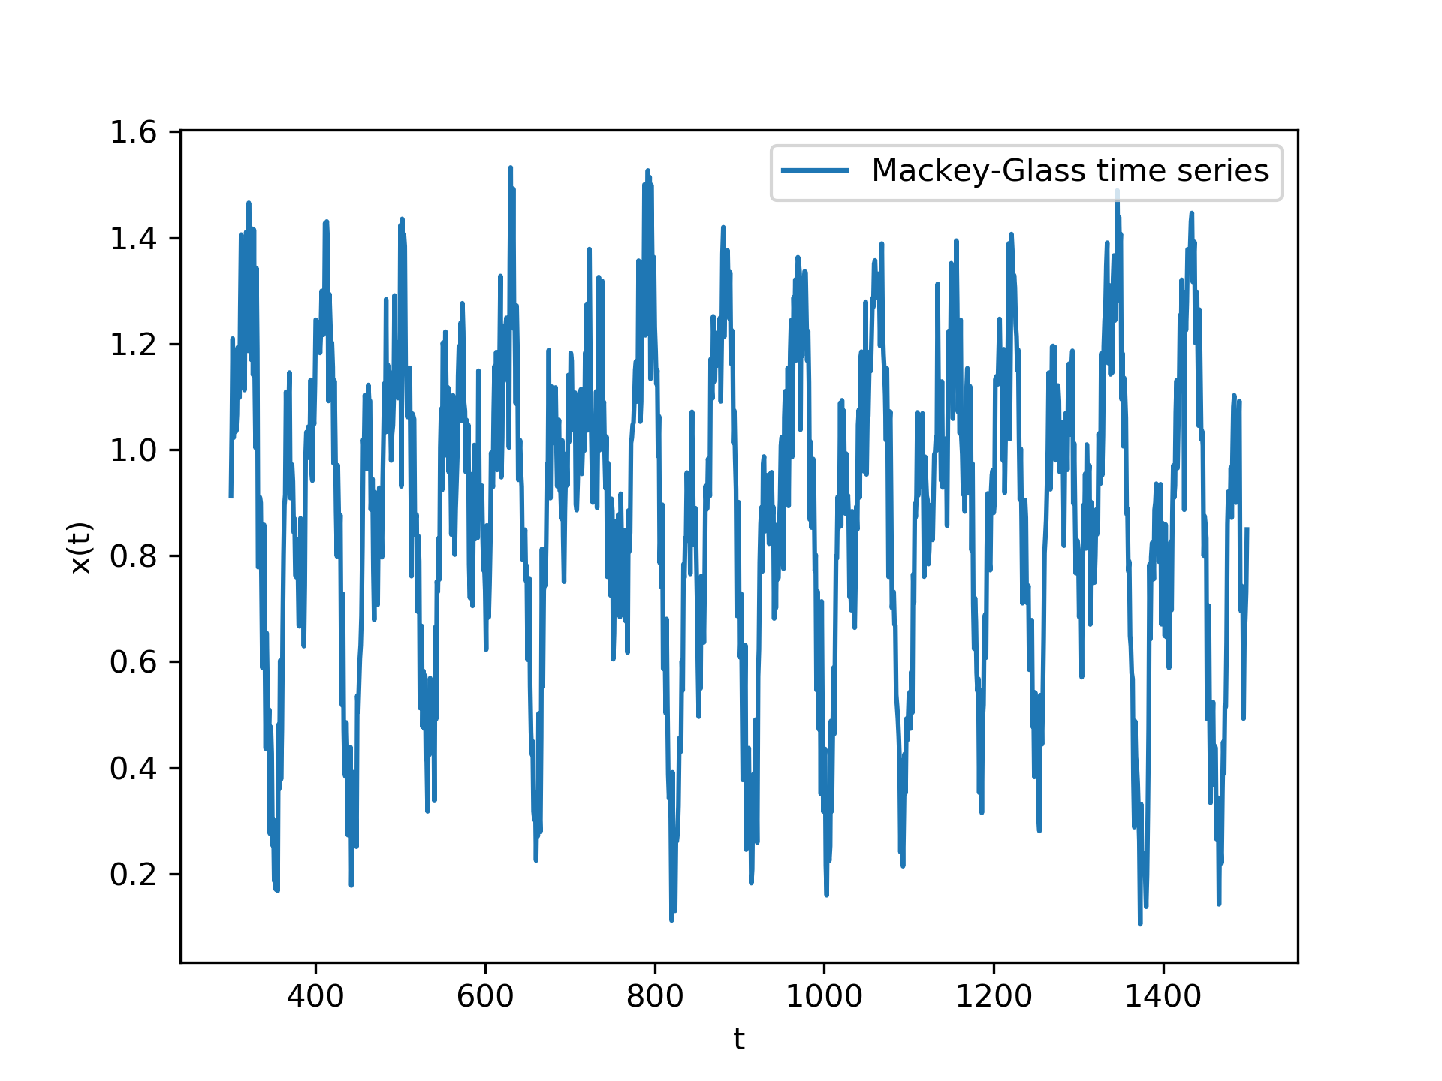
Noisy data
noise added to output (sigma from {0.03, 0.09, 0.18})
(a) noiseless vs noisy (0.09) time series
Notes:
For the second part of the assignment, we’ve added Gaussian zero-mean noise to all of our outputs/target values. We can see the difference between a noiseless and a noisy time series in figure (a). The right plot is the result of using a zero-mean normal distribution with a standard deviation of 0.09.

Slide 26
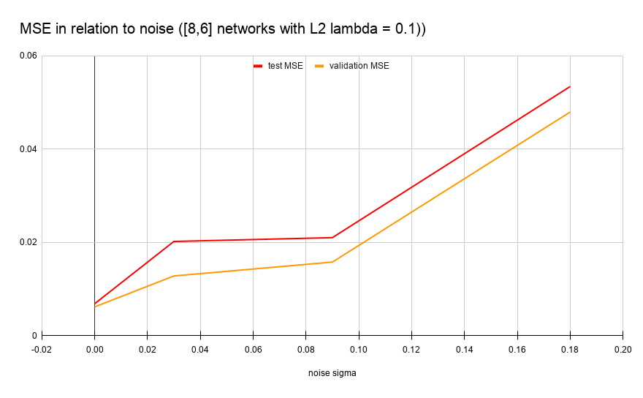
Noisy data: errors
all sets show larger errors
(a) increase of test and validation errors with noise
Notes:
Since we add noise to our data the true underlying function is less visible to the network and for this reason error increases on all sets. Also, the irreducible error itself increases. For example figure (a) show an increase of the test and validation error with the addition of noise.

Slide 27
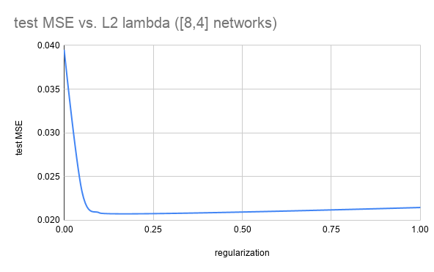
Noisy data: regularization
incentive to increase regularization strength
overfitting due to noise (and an additional layer)
best results with lambda = 0.1
(a) test MSE vs. regularization strength
Notes:
As we add noise to our dataset there is incentive to increase the regularization strength since the chances of overfitting increases. As we added another layer these chances are further increased. Figure (a) shows the effects of regularization strength on the test mean square error in a three layer perceptron. Best results were achieved using a lambda of 0.1, 10 times higher than when using a 2-layer perceptron and data without noise

Slide 28
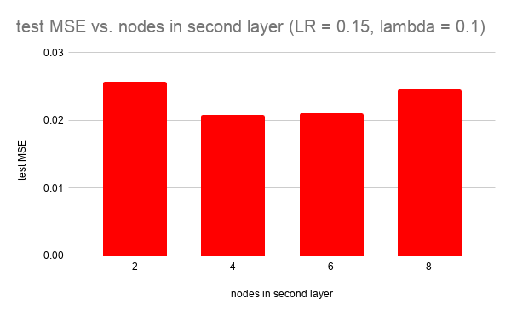
Noisy data: two-layered vs. three-layered
best configuration
8-4 architecture with a learning rate of 0.15
marginally worse than our previous two-layer architecture
two-layer (8) MSE 0.020
three-layer (8-4) MSE 0.021
training cca. 50% longer
(a) MSE vs. nodes in 2nd layer
Notes:
We have tested three layer architecture with 8 nodes in the first, and then 2, 4, 6 and 8 nodes in the hidden layer. The 8-4 architecture showed a slightly better performance than the others. In general, the three-layer networks performed marginally worse than a two-layer network with 8 hidden nodes, probably due to unneeded complexity which can cause overfitting, and they also take around 50% more time to train, which makes sense in the context of the backpropagation algorithm.

Slide 29
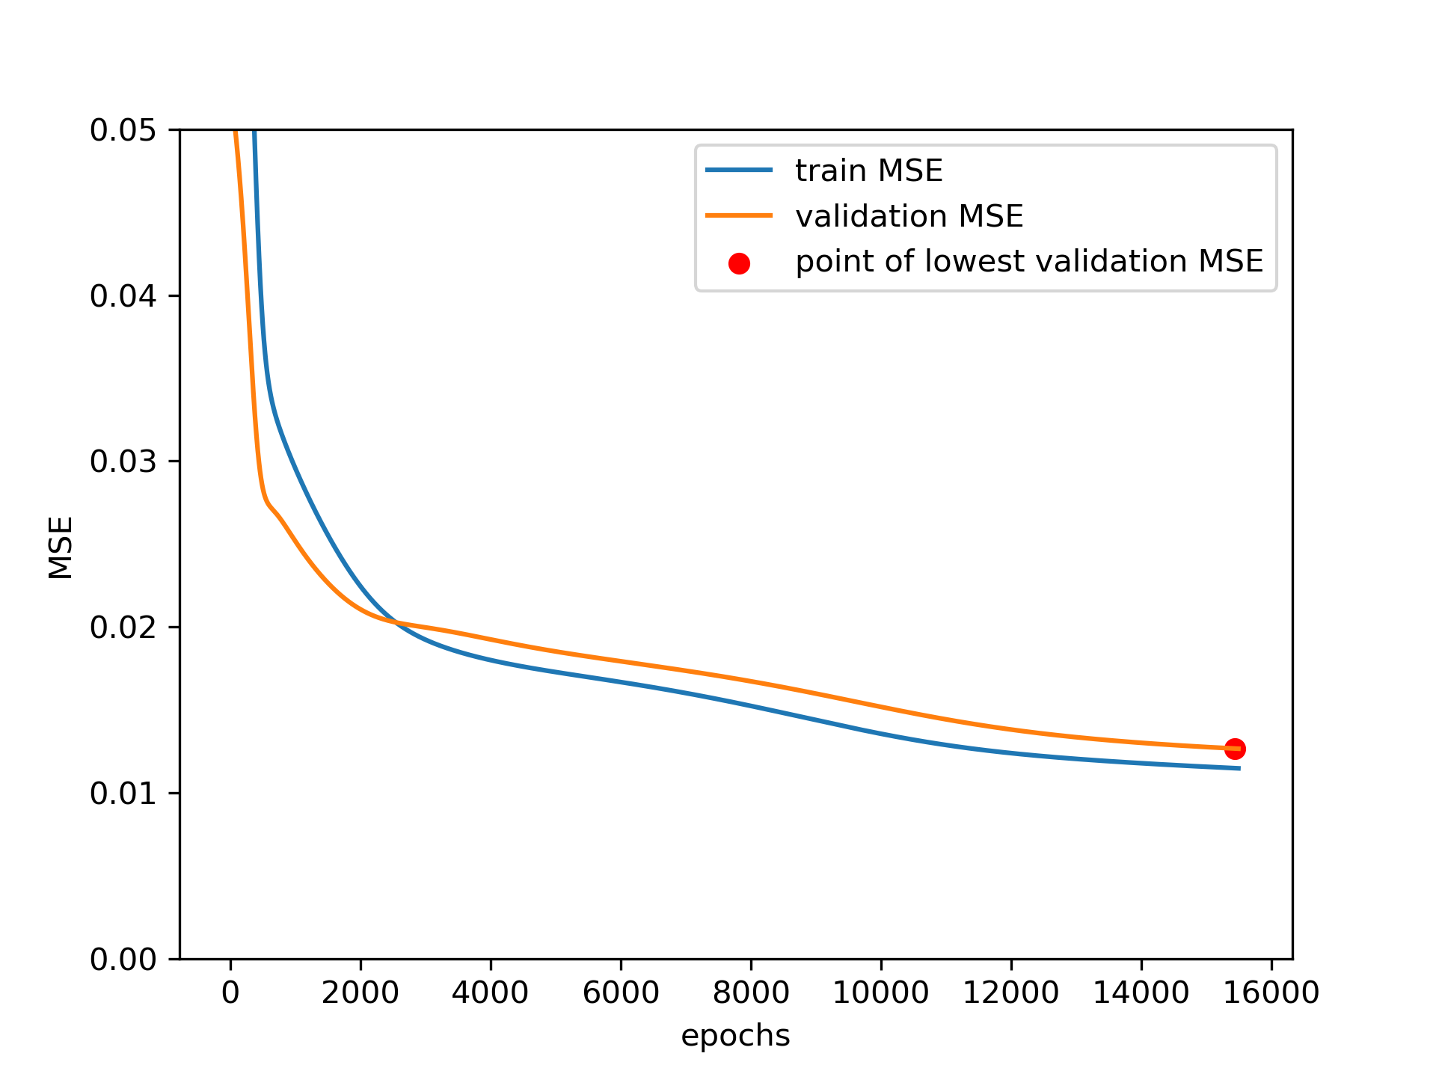
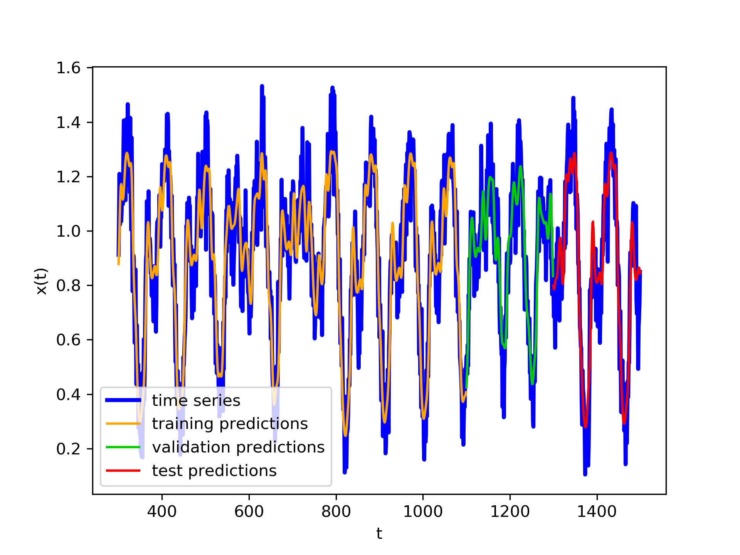
Noisy data: performance
(a) learning curves
(b) time series predictions
Notes:
Finally, here we can see the learning curves and the prediction of the best three-layer network. The results are expected, the validation error is slightly higher than the training error and both decrease over time. The prediction plots shows fairly good results and good generalisation capability of the network.

Slide 30
Thank you

